Slide 1

Brent Solomon, Principal-Reznick Group, P.C.
Karl Knoll, Partner-Womble Carlyle Sandridge & Rice, LLP
ANGEL VENTURE FORUM
GEORGETOWN
September 28, 2012
Valuations: How to Value Your Company for Investors
www.wcsr.com

Slide 2
VALUATION BASICS
Many Methods - 3 Categories
Cost Approach
- Reproduction Cost
- Replacement Cost
Income Approach
- Capitalization of income
- Discounted cash flow
Market Approach
- Comparable public or private companies
- Multiple of revenue
- Multiple of EBITDA
www.wcsr.com

Slide 3
VALUATION CHALLENGES
Early Stage Companies
Cost Based
- Cost may not reflect proprietary value
- Rarely used
Income Based
- Little or no current income
- Projections generally highly speculative
Market Based
- Little or no current revenue/earning to apply multiple
- Finding comparable company/transaction data
www.wcsr.com

Slide 4
VENTURE CAPITAL
Rates of Return
www.wcsr.com

Slide 5
INVESTOR VALUATION
Practical Economics
Percent of company that VC receives
“Pre-money”
“Post-money”
Impact of options
www.wcsr.com

Slide 6
INVESTOR VALUATION
Practical Economics
Pre-Money Valuation (% of company received for the investment)
Type of security (Preferred Stock vs. Common Stock)
Dividends (Cumulative vs. Non-cumulative)
www.wcsr.com

Slide 7
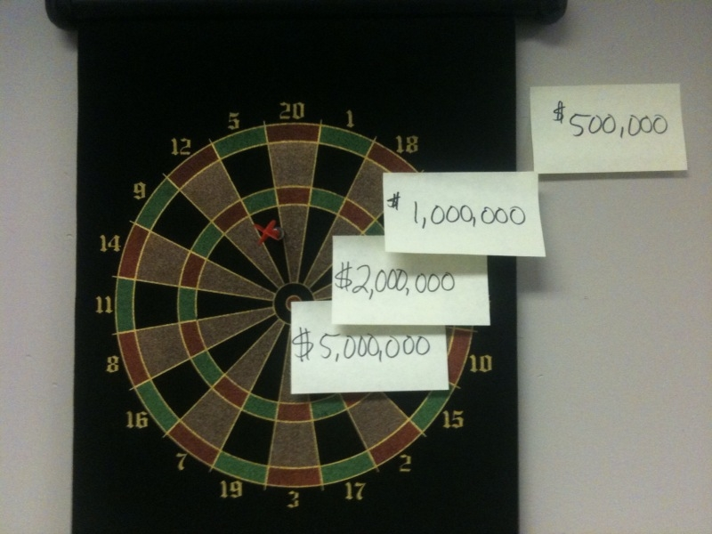
Venture Capitalist’s
Pre-Money Value Modeler
www.wcsr.com

Slide 8
Factors Influencing Pre-Money Value
Market opportunity (size of market, etc.)
Strength of the team (Experience vs. Enthusiasm)
Strength of the IP (or other barriers to entry)
Strength of the competition
Customers/revenue
Exit opportunities (obvious purchasers)
Expected exit timing
Competition among investors
www.wcsr.com

Slide 9
Venture Capital Term Sheet
Major Issues
Economics (dividing the pie on exit)
Control (who is going to pilot the ship)
Shareholder Rights (protecting the investment and getting to the exit)
www.wcsr.com

Slide 10
Venture Capital Term Sheet
Equity “Value” Preferences
Conversion feature
- Percent of equity “as if converted”
Participation Rights
- Full capped
- None
Liquidation rights/preference
- Initial investment
- Multiple of initial investment
Dividends
- Cumulative
- Non-cumulative
Price protection/anti-dilution
www.wcsr.com

Slide 11
Valuation Post Funding
Where Did the Value Go?
Pre-money/post-money valuations are on a “as if converted” basis
Preferences on liquidation, dividend, control and participation rights on preferred not common
Preferred is often worth substantially more than common
Where did the value go?
Valuation experts have techniques to:
- Allocate total enterprise/equity to classes
- Back-solve for enterprise/total equity value based on the preferred funding price and preferences
www.wcsr.com

Slide 12
Valuation – Typical
Needs for Emerging Businesses
Issue stock to key employees
Issue restricted stock to key people
Issue incentive or non-qualified options
Issue stock as merger/acquisition consideration
Financial reporting
Exit/sale
www.wcsr.com

Slide 13
Contact Information
Brent S. Solomon MSF, CPA/ABV, CVA, CFF, CM&AA Principal National Practice Leader Valuation Advisory Services Reznick Group, P.C. 7501 Wisconsin Avenue Suite 400E Bethesda, MD 20814 Direct: 301-280-3660 Main: 301-652-1900 Fax: 301-280-3661 Cell : 240-475-1834 brent.solomon@reznickgroup.com | Karl T. Knoll Partner Womble Carlyle Sandridge & Rice, LLP 8065 Leesburg Pike 4th Floor Vienna, VA 22182 Direct: 703-394-2279 Office: 703-790-3310 Cell: 703-589-2428 Fax: 703-918-2290 kknoll@wcsr.com

